Slide 1



WEBDUO
VDwell
VDwell:The platform where We and Video dwell together.
PRESENTED BY
Sayali Kadam
Joyee Biswas
09-09-23

Slide 2

WEBDUO
PROBLEM STATEMENT OVERVIEW:
Create a short video content viewing online platform that can:
View short video content (max 10sec)
Upload /create short videos

Slide 3
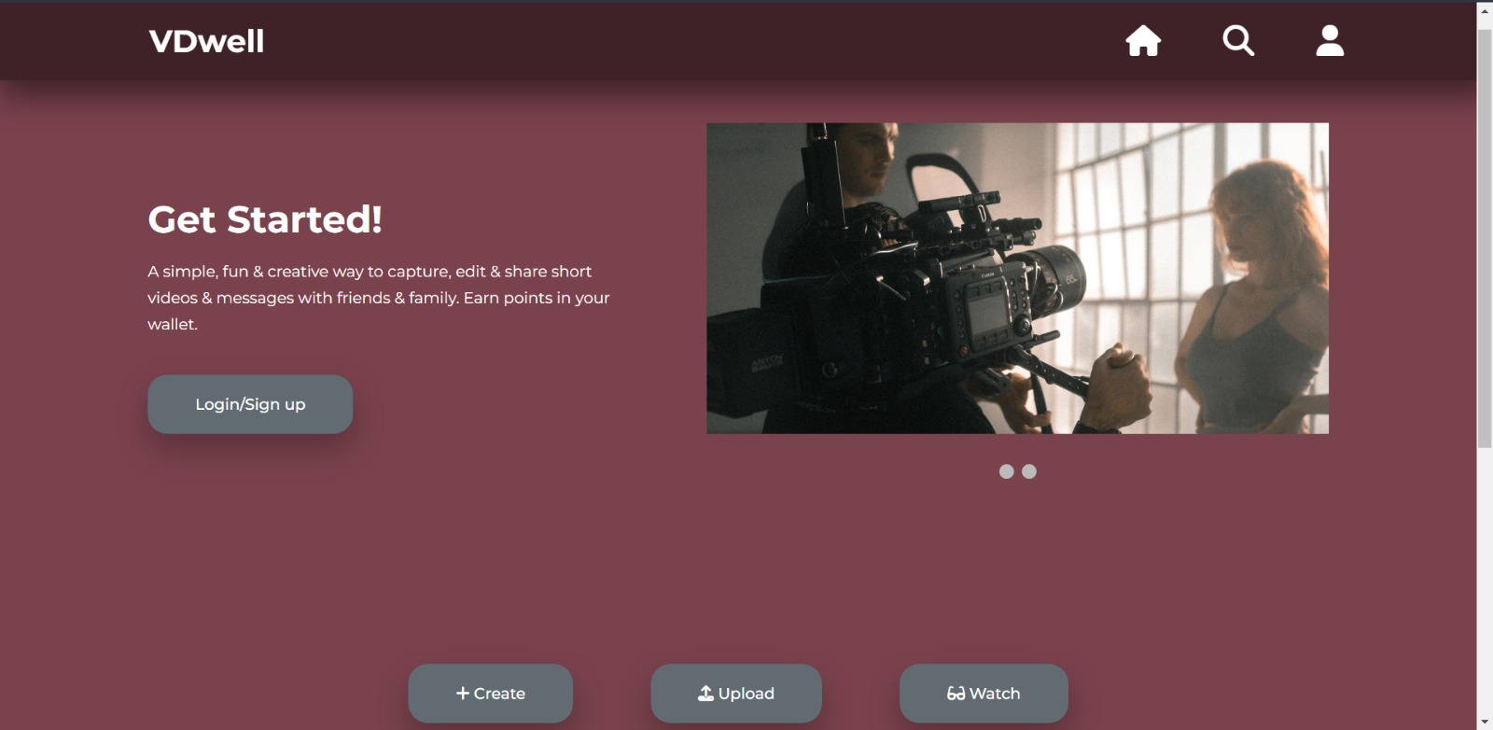
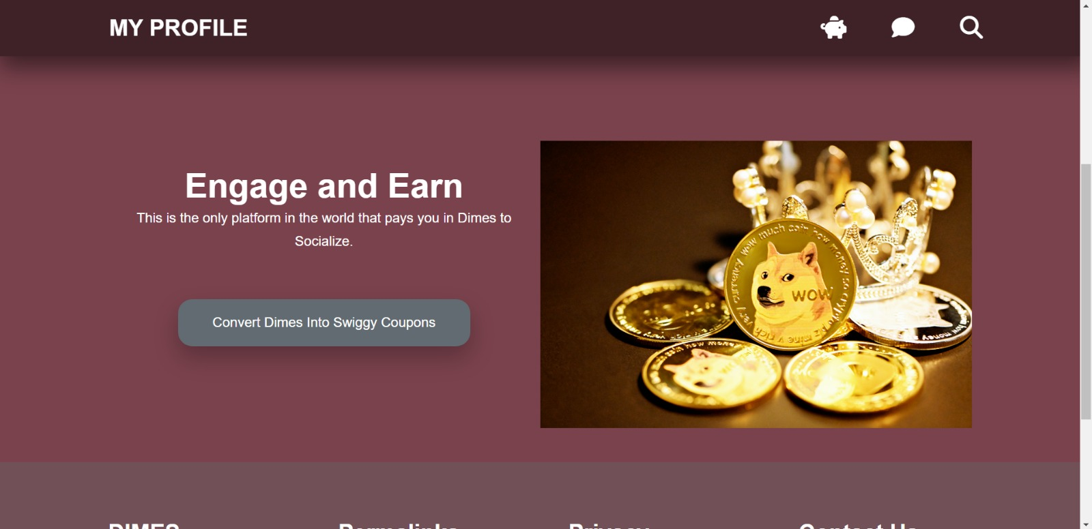
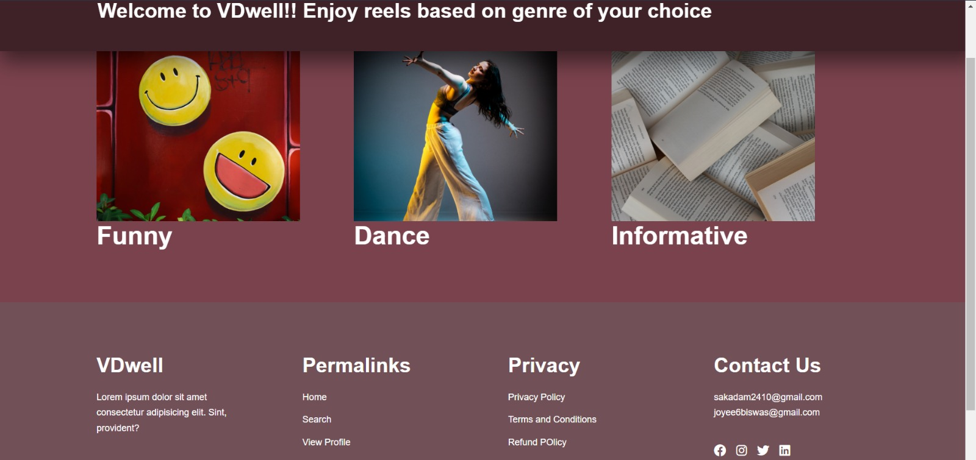

OUR FEATURES

Slide 4
OUR UNIQUE FEATURES
Engage and Earn
Share video clips with others and earn our dimes to real currency .
1 dime = 100 rupees

Slide 5


WEBDUO
Our Target Market
Back to Agenda
From analysis, our major target market is the age group from 18-34yrs
Chart depicting raw distribution of users by age group

Slide 6
ESTIMATED BUDGET
Recurring Maintenance Costs: $100 per month
Tech Support: $2–$300 per month
Domain name: $0–$20 per year

Slide 7





WEBDUO
Future Development
Kidsafe mode for children from 13 to 17yrs
Recommendations and suggestions for video clips
Chats with friends , family and people over the world
Filtering videoclips based on different parameters like most viewed , latest , etc.
Back to Agenda

Slide 8

WEBDUO
For inquiries, contact us.
EMAIL
SOCIAL MEDIA
CALL US
joyee6biswas@gmail.com
_sai.ily_
123-456-7890

Slide 9


